Slide 1
Modeling the pandemic – The SIR model and its variants
Now that we have briefly talked about scientific modeling in general, we are going to start discussing epidemic modeling specifically
More precisely, we are going to study the SIR model and its variants
This is the basic model of the epidemiology of infectious disease and most of the more complicated models that are used in practice are based on it

Slide 2
Modeling the pandemic – The SIR model and its variants
The key feature of this family of models is that they divide the population into several classes or compartments and then model the transition between them
This is why they are called “compartmental models”
The SIR model divides the population into 3 compartments: S(usceptibles)-I(nfected)-R(ecovered)

Slide 3
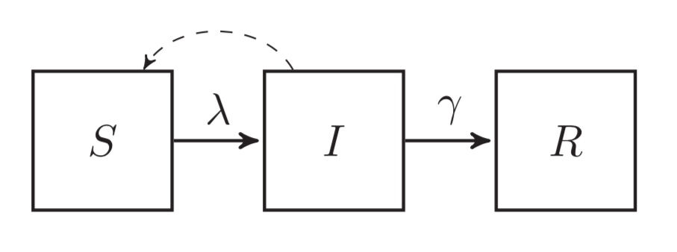
Modeling the pandemic – The SIR model and its variants
The SIR model

Slide 4
Modeling the pandemic – The SIR model and its variants
N = S + I + R = total population
π = probability of being infected upon exposure
ρ = contact rate (think of it as the average number of contacts per day people have)
So β = πρ is the rate at which infected individuals would successfully transmit the virus if everyone they had a contact with were susceptible
In that case, the daily number of new infections would be βI

Slide 5
Modeling the pandemic – The SIR model and its variants
However, not everyone is actually susceptible, so in reality the daily number of new infections is less than that because only some of the contact infected people have can result in transmission of the virus
When you take that into account, the daily number of new infections becomes βI = Sλ with λ = β = force of infection
This means that the daily change in the number of susceptible is equal to -βI
$\frac{S}{N}$
$\frac{I}{N}$
$\frac{S}{N}$

Slide 6
Modeling the pandemic – The SIR model and its variants
But people also recover and thus leave the I(infected) compartment to move into the R(ecovered) compartment
γ = recovery rate (think of it as the probability of recovering during any given day)
So the daily change in the number of recovered is γI
This also affects the daily change in the number of infected, which becomes βI - γI
$\frac{S}{N}$

Slide 7
Modeling the pandemic – The SIR model and its variants
The recovery rate γ is related to the average duration D of the infectious period, i. e. the time people spend in the I(nfected) compartment
γ =
This is just what it means to say that γ is the probability of recovering during any given day
$\frac{1}{D}$

Slide 8
Modeling the pandemic – The SIR model and its variants
If we put all this together, we get the following system of differential equations
$\frac{dS}{dt}=−βI\frac{S}{N}$
$\frac{dI}{dt}=βI\frac{S}{N}−γI$
$\frac{dR}{dt}=γI$

Slide 9
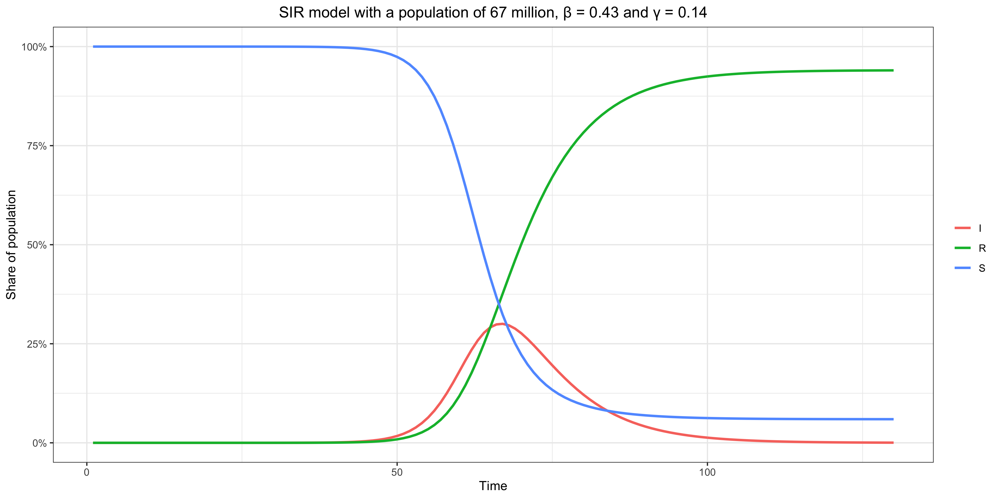
Modeling the pandemic – The SIR model and its variants

Slide 10
Modeling the pandemic – The SIR model and its variants
Basic reproduction number and effective reproduction number in the SIR model
Note that the epidemic will start receding when the number of people in the infected compartment starts going down, i. e. or
This condition can be rewritten as
But is the average number of people that someone who is infected would infect during the course of the infectious period if everyone in the population were susceptible, which is called the basic reproduction number (noted R₀)
Not everyne in the population is susceptible though, so is the average number of people that someone who is infected actually infects, which is called the effective reproduction number (noted R_{t}), and the condition just means that the epidemic starts receding when the effective reproduction number falls below 1
$βI\frac{S}{N}−γI<0$
$βI\frac{S}{N}<γI$
$\frac{β}{γ}\frac{S}{N}<1$
$\frac{β}{γ}=βD$
$\frac{β}{γ}\frac{S}{N}$

Slide 11
Modeling the pandemic – The SIR model and its variants
This makes intuitive sense if you think about it, because the basic reproduction number depends on the rate of transmission β but also on D which is just 1/γ
Meanwhile, the effective reproduction number is just the product of the basic reproduction and the proportion of susceptible in the population
For instance, if the basic reproduction number is 3 and 1/3 of the population has been infected and has recovered, someone who is infected will on average infect 2 people so the I(nfected) compartment will continue to grow
But if 2/3 of the population has been infected and has recovered, he will only infect 1 person on average, because 2/3 of the people he interacts with are no longer susceptible so the I(nfected) compartment will stop growing

Slide 12
Modeling the pandemic – The SIR model and its variants
At the beginning of the epidemic, when almost everyone is susceptible, the epidemic grows quasi-exponentially (i. e. at constant rate)
However, this doesn’t last, because due to people getting infected and becoming immune R_{t} gradually goes down
Because the SIR model assumes that infection takes place at constant rate, it implies that the generation time is exponentially distributed, in which case R_{t} = 1 + g(t)T (where R_{t} is the effective reproduction number, g(t) the epidemic growth rate and T is the mean generation time)
So g(t) = (R_{t} – 1) / T which decreases as R_{t} goes down and becomes < 0 when R_{t} < 1

Slide 13
Modeling the pandemic – The SIR model and its variants
More on the distinction between the basic reproduction number and the effective reproduction number
The basic reproduction number refers to a hypothetical situation in which everyone in the population is susceptible, which is never the case, so we can’t directly observe it because it’s never the case that everyone in the population is susceptible
But the situation at the beginning of the epidemic comes pretty close, which is why it’s typically measured at the beginning of outbreaks, although there are other methods
Despite what you often hear, even from epidemiologists, this is not an intrinsic property of the virus, so it makes no sense to talk about the basic reproduction number of SARS-CoV-2, influenza, measles, etc.
It depends on many things that can be and are in fact different in different populations, such as culture, behavior, population density, etc.
Even in the same population, it can be different at different times, because those things can vary over time for all sorts of reasons

Slide 14
Modeling the pandemic – The SIR model and its variants
The effective reproduction number is the average number of people a person who is infected at time t actually will go on to infect, so it doesn’t refer to a hypothetical situation
Unlike the basic reproduction number, this refers to the actual situation at a given time, not a hypothetical situation in which everyone is susceptible
It’s different from the basic reproduction number because, if everyone were susceptible, some people that were not infected despite being exposed would have been infected

Slide 15
Modeling the pandemic – The SIR model and its variants
The SIR model rests on unrealistic assumptions
Homogeneous population mixing
No one dies from the disease
No demography (i. e. nobody is born or dies from other causes)
Immunity doesn’t wane
Infection and recovery processes are assumed to take place at constant rate
No latency period between infection and infectiousness
Etc.

